Slide 1

Housing Project- Predicting SalePrice
Khushboo Khatri

Slide 2
“It’s one small step for man, one giant leap for mankind.”
- Neil Armstrong

Slide 3
Introduction
Problem Statement:
Houses are one of the necessary need of each and every person around the globe and therefore housing and real estate market is one of the markets which is one of the major contributors in the world’s economy. It is a very large market and there are various companies working in the domain. Data science comes as a very important tool to solve problems in the domain to help the companies increase their overall revenue, profits, improving their marketing strategies and focusing on changing trends in house sales and purchases.
A US-based housing company named Surprise Housing has decided to enter the Australian market. The company uses data analytics to purchase houses at a price below their actual values and flip them at a higher price.
The company is looking at prospective properties to buy houses to enter the market. You are required to build a model using Machine Learning in order to predict the actual value of the prospective properties and decide whether to invest in them or not. In short we need to Predict the Prices of the properties for the dataset Provided, so that the company can decide weather to invest or not.

Slide 4
Business Goal
You are required to model the price of houses with the available independent variables. This model will then be used by the management to understand how exactly the prices vary with the variables. They can accordingly manipulate the strategy of the firm and concentrate on areas that will yield high returns. Further, the model will be a good way for the management to understand the pricing dynamics of a new market

Slide 5
Technical Requirements
Data contains 1460 entries each having 81 variables.
Data contains Null values. You need to treat them using the domain knowledge and your own understanding.
Extensive EDA has to be performed to gain relationships of important variable and price.
Data contains numerical as well as categorical variable. You need to handle them accordingly.
You have to build Machine Learning models, apply regularization and determine the optimal values of Hyper Parameters.
You need to find important features which affect the price positively or negatively.
Two datasets are being provided to you (test.csv, train.csv). You will train on train.csv dataset and predict on test.csv file.

Slide 6
Analytical Problem Framing
We got two dataset in the form of csv file:
1) Test dataset – it has 292 rows and 80 columns, which we use in the final prediction.
2) Train dataset – It consist of 1168 rows and 81 rows, the extra column here denotes the SalesPrice . This dataset is the one which we will use in training the model.
Those 80 rows consist of various features including quality, condition, material of the property including basement , garage, exterior, kitchen, heating, central air, neighbourhood, street etc. what all the features that comes in ones mind when dealing with the property.
And our Label or target column here is SalePrice, which denotes the selling price of the property in the market considering all the factors.

Slide 7
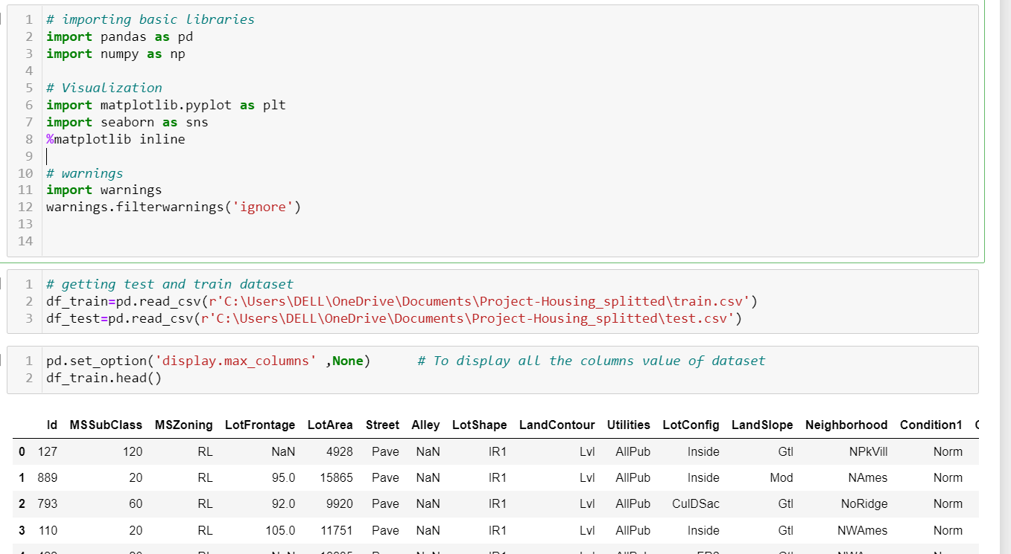
DataSource and their Format
The data is provided us by FlipRobo in the form of .csv files, which we load in the Jupyter Notebook in order to perform Data Cleaning and Pre-processing for building our ML Model.

Slide 8
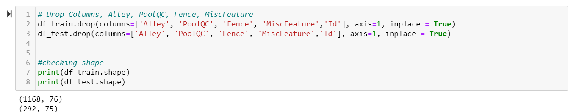
Data Pre processing
Data preprocessing is a technique use to processed the data set, in order to get clean, normalised/standardised data for model building. As we know that real life data has lots of missing information, skewness , outliers, we need to process them accordingly, so that our model performs better.
Let’s starts with dropping unwanted columns or columns with lots of missing info.

Slide 9
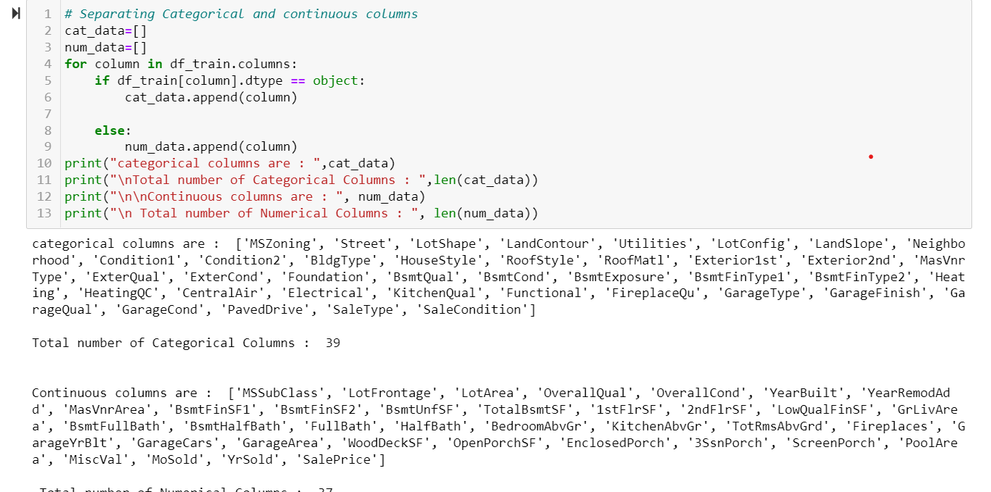
Next step is, to separate columns on the basis of their data types, this will help us in visualization as well as in Handling missing values and encoding the data.

Slide 10
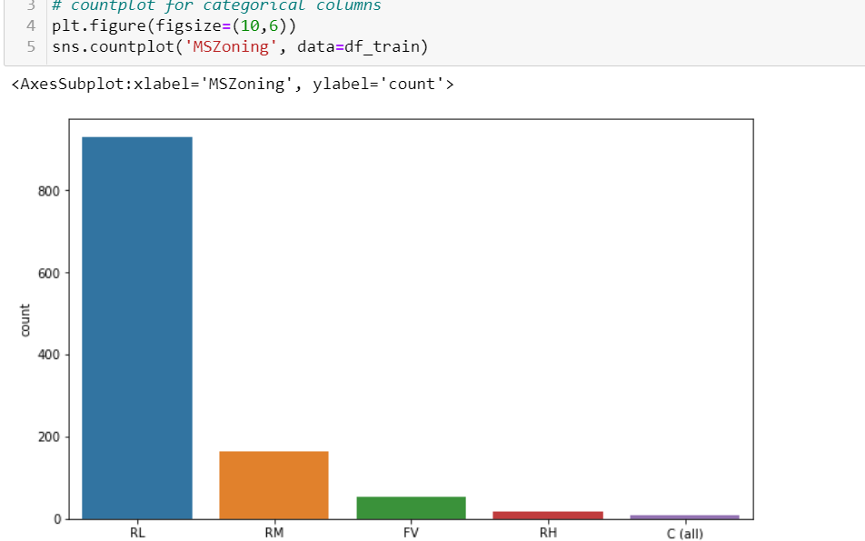
EDA .
Exploratory Data Analysis (EDA) is an approach to analyze the data using visual techniques. It is used to discover trends, patterns, or to check assumptions with the help of statistical summary and graphical representations. We will perform Univariate and Multivariate analysis. Let’s starts with Univariate analysis, it helps us to analyse every single column and can get fair idea about how data is distributed.
From here we can observe that people enjoy low density residential area, when talking about zone of property.

Slide 11
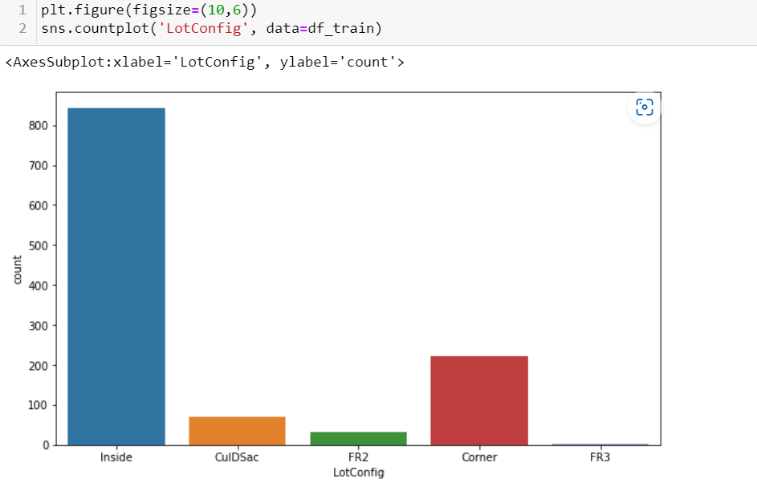
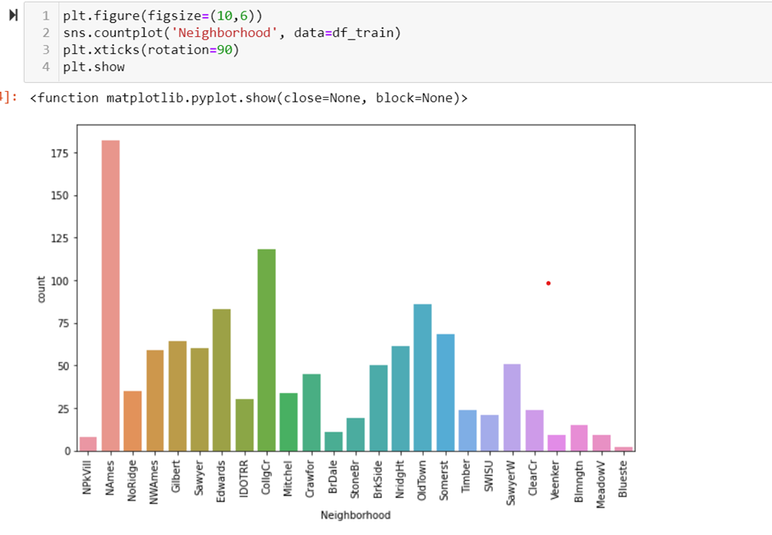
We can observe in the first plot which represents the Lot configuration, more sales are for inside plot. Similar the second plot North ames neighbourhood is highly popular.

Slide 12
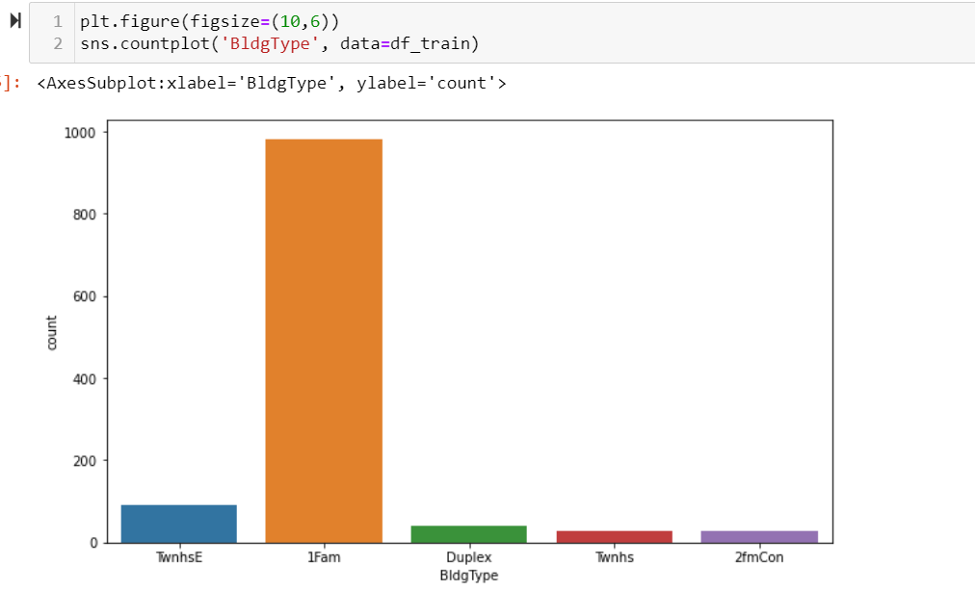
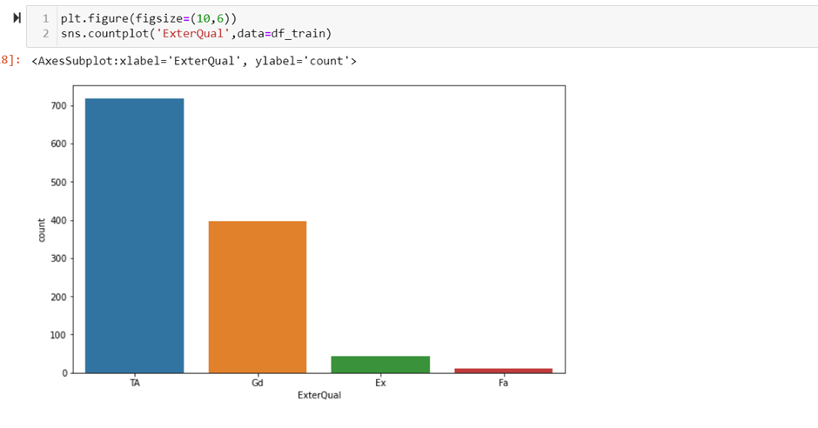
We can observe that single family detached houses gets highest response, similarly in second plot it is interesting to observe that typical/average external quality gets highest vote.

Slide 13
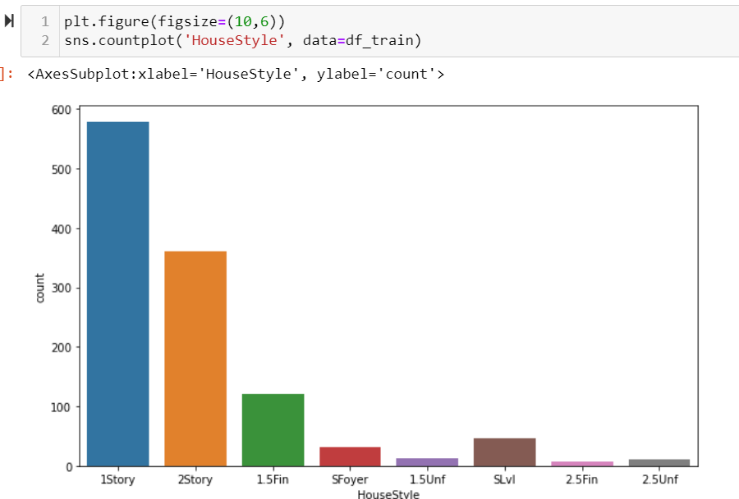
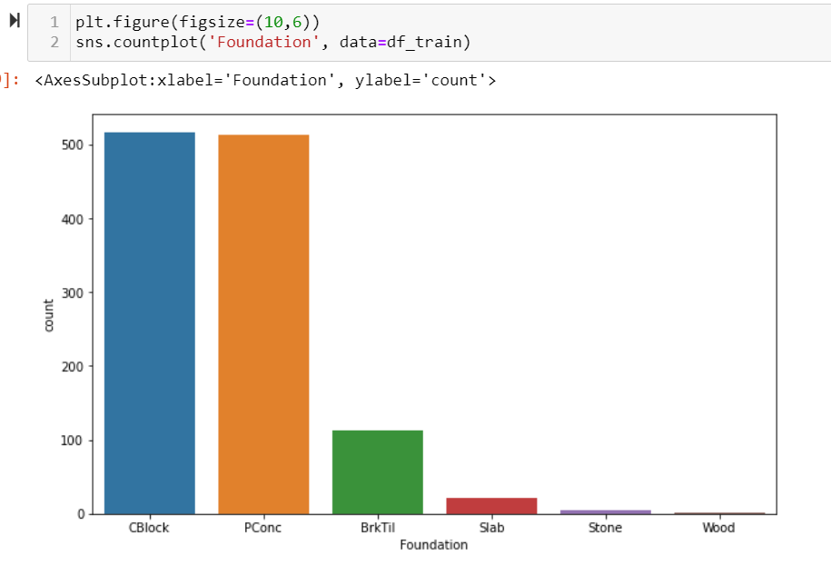
We can observe that 1 story single family houses are in demand, which is understandable from choice of Building Type. And the foundation material for most of the property are either Cblock or Pconc.

Slide 14
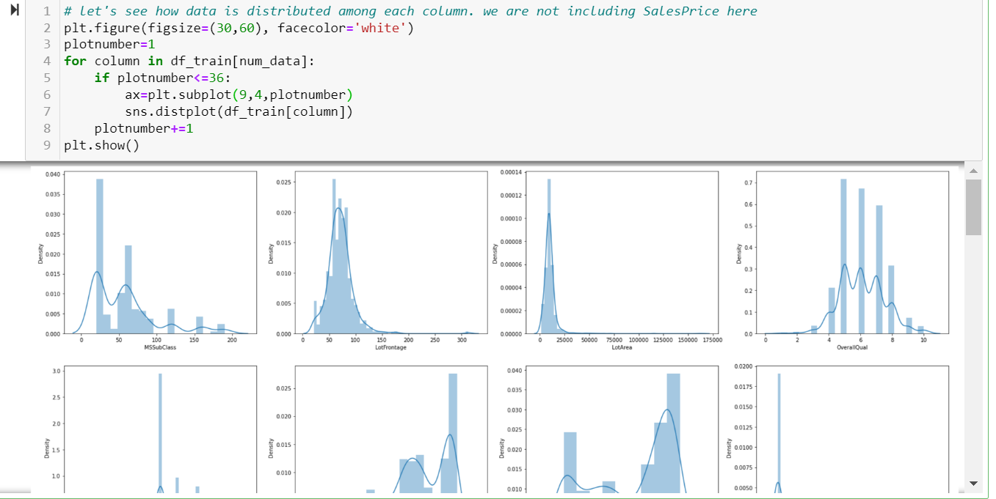
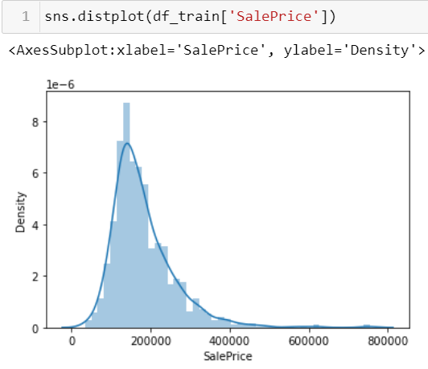
We can observe that in the first plot we run a loop in order to visualise the distribution of every single continuous columns, And second plot is distribution of data in our label column.
This helps us to get an insight about our data, we came to know that in numerical column there are some discrete data columns and some are continuous.
Distplot is helpful when we wish to plot numerical columns,while countplot are helpful in categorical column visualization.

Slide 15
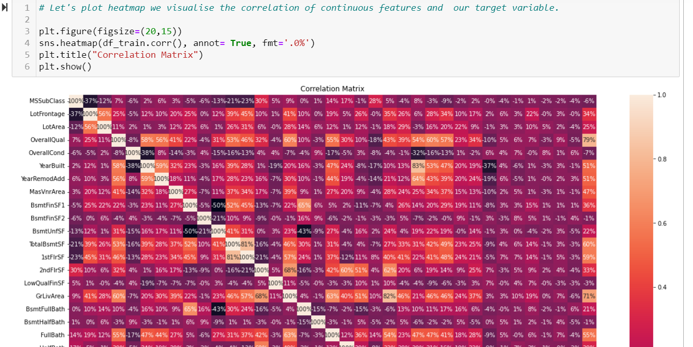
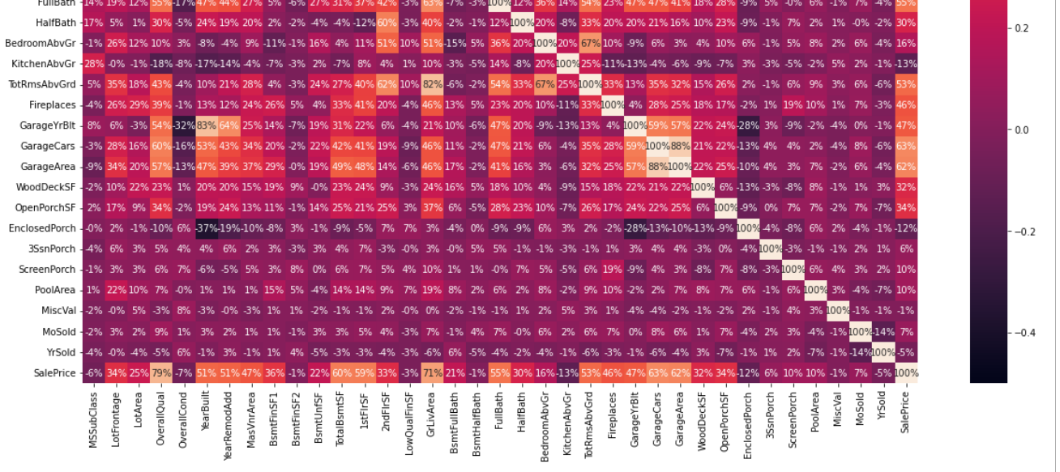
Multivariate Analysis: Helps to find relation between various columns of the dataset. Let’s start with Correlation Matrix

Slide 16
We plot correlation matrix to show which variable is having a high or low correlation in respect to another variable.
Some of the Observation made from our correlation matrix, One thing is to note that here, the correlation matrix is draw between continuous variables only.
Observations:
We can observe that BsmtFinSF2, BsmtHalfBath, MiscVal are least correlated features followed by LowQualFinSF. We can drop them.
While OverallQual, followed by GrLivArea are highest correlated features.
We can also observe that some of the features are highly correlated with each other as well, like : GarageCars-GarageArea, GrLivArea-TotRmsAbvGrd, GarageYrBlt-YearBuilt.
Let's confirm their correlation using scatterplot ,then we need to drop one out of the two, so that we don't see multicolinearity in our data.

Slide 17
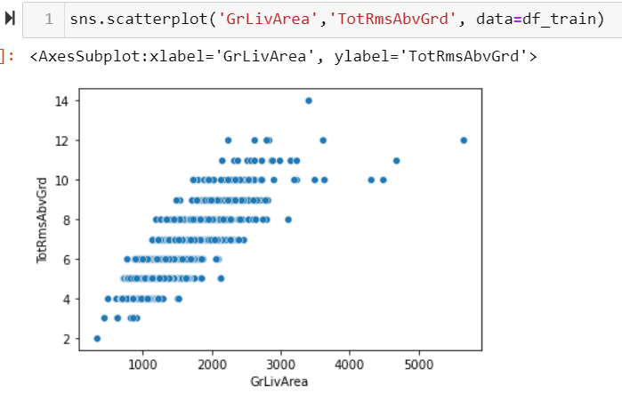
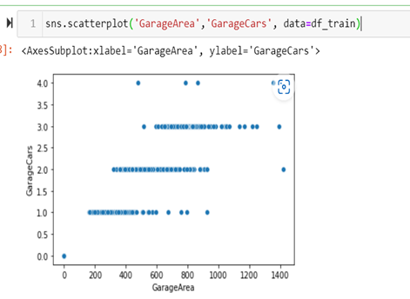
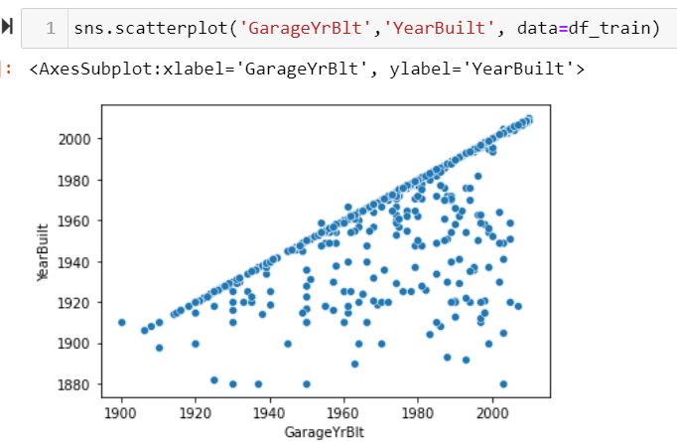
From above three scatter plot we tried to establish correlation between the columns, We can see clear positive correlation between first graph, while in second graph there is no definite form of correlation. Wherein third plot, the data distribution is very distorted. There is positive correlation but it was not so strong.
In order to avoid multicollinearity we will drop TotRmsAbvGrd as it is less correlated to sale price out of two. So the next step will be dropping all the unwanted columns.

Slide 18
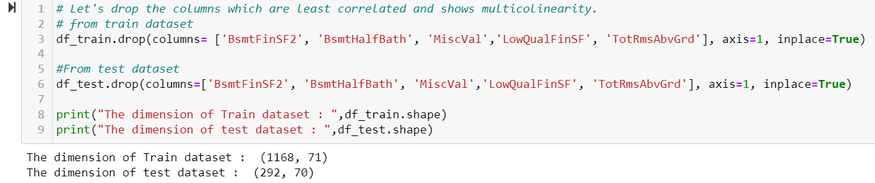
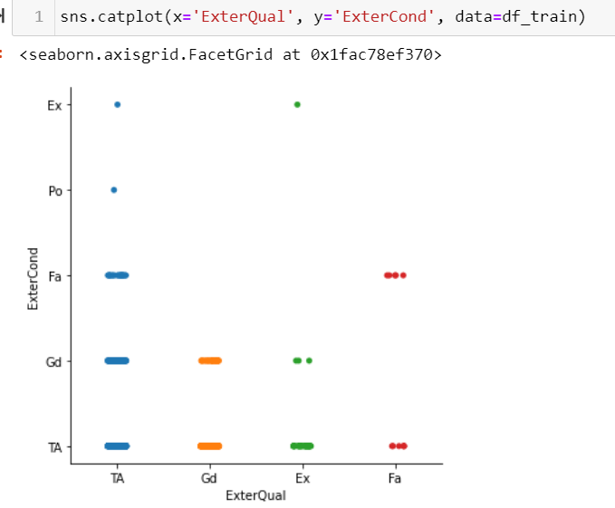
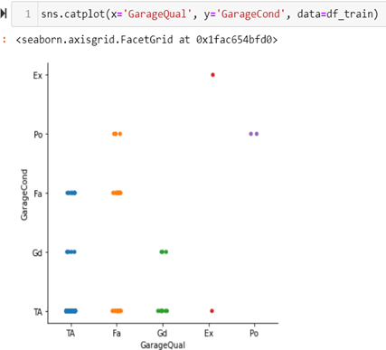
Let’s drop all those not so important columns.
In EDA we plot catplot basically for ordinal data
we can see that there is less difference between condition and quality of both Exterior and garage.

Slide 19
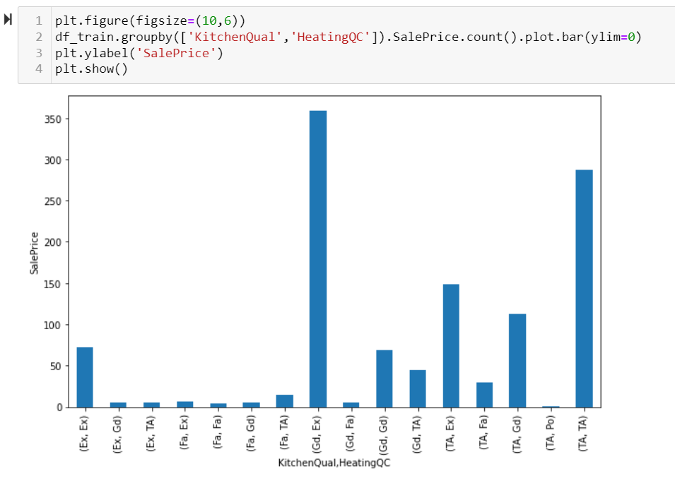
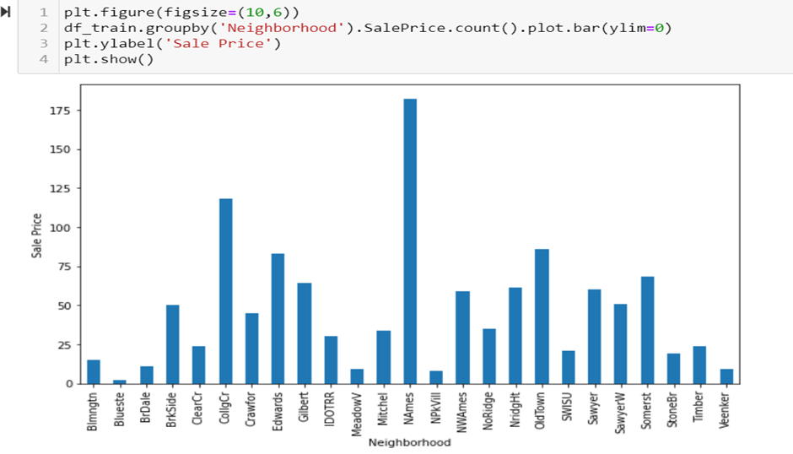
1) From above observation we can say that both Kitchen Quality and Heating Quality are related to SalePrice, we can see that for Good Quality Kitchen and Excellent Heating Quality got highest sales price.
2 ) We already establish that North Ames Neighborhood got highest SalePrice, It is the most popular neighborhood to live in. While Blueste Neighborhood has lowest SalePrice.

Slide 20
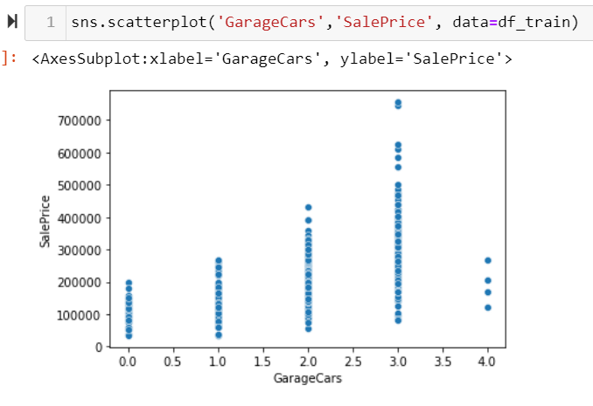
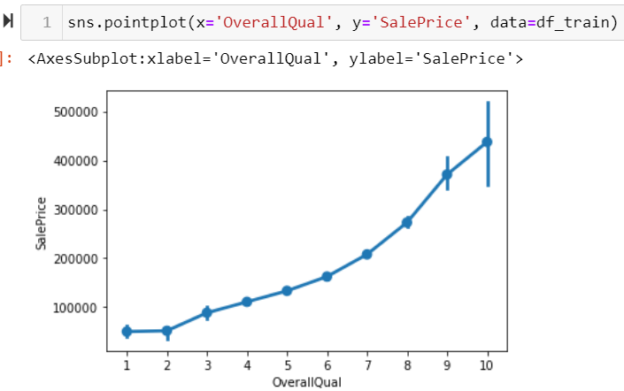
From first graph we can observe that the sales price of property with 3 Garagecars are high.
And for second plot it is clear that as the overall quality increases the sales price of the property also increases.

Slide 21
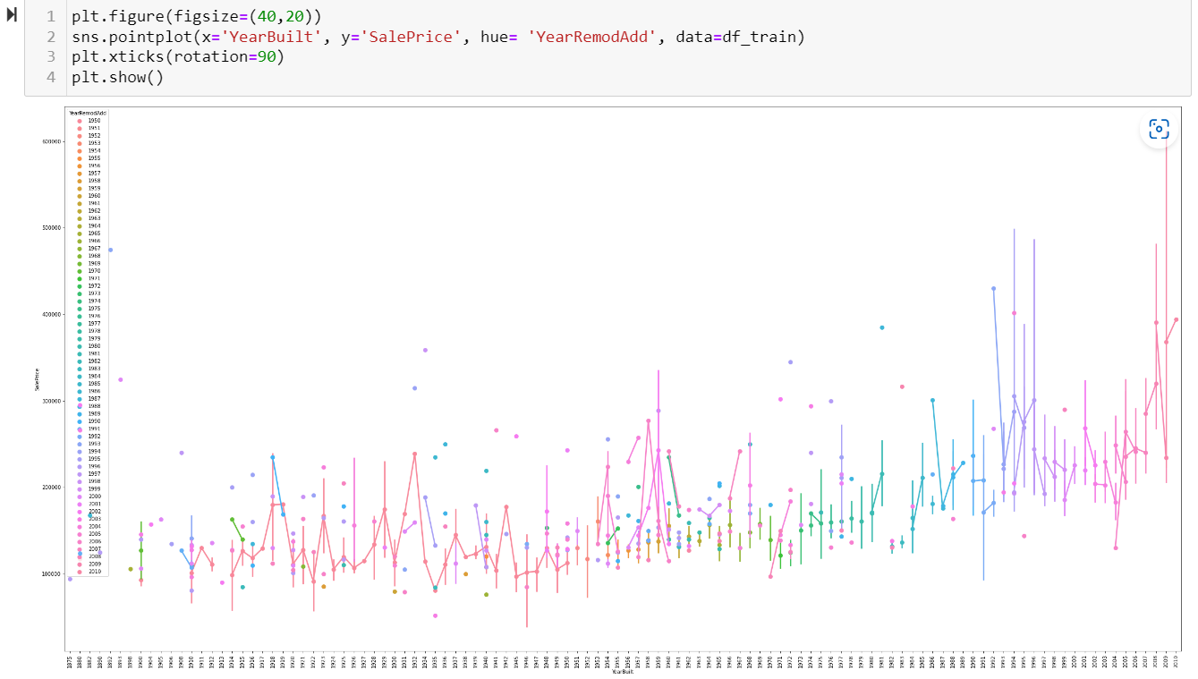
We can observe that the sale price for remodel houses are higher, The house Built in year 2010 or Remodel from 1990-2010 gets good sale Price.

Slide 22
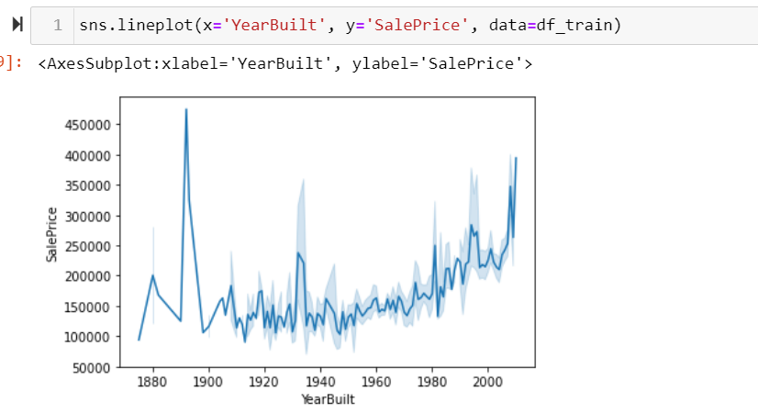
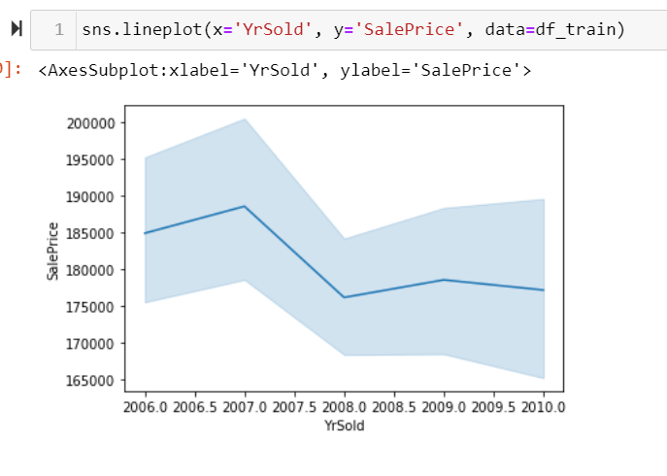
From first plot we can observe from above plot that the sales price were highest for ancient 1890-1900 well build well maintained property, then the sale price drop and gradually increases with YearBuilt.
From second plot we can observe that the sale price of houses increases from 2006-2007 then decreases in 2008 may be because of recession. then they never hit high again

Slide 23
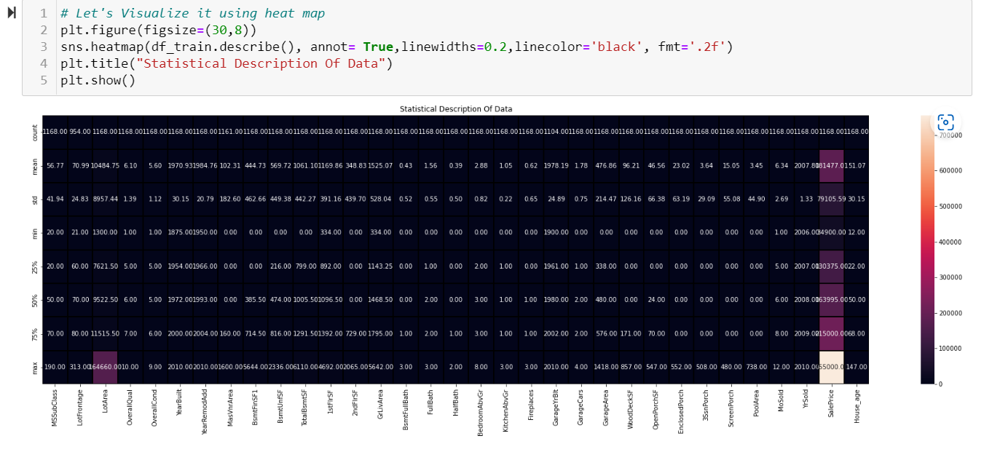
Statistical Description Visualization
We can see that our numerical data, looks good. 25% data represents q1 while 75% represents q3. we also got the min and max data of every column. While looking at the mean and std we can say that we need to scale our data before ML model building.

Slide 24
Handling missing Values.
Handling Missing Values in a dataset is very important, for that purpose we merge out train dataset with test dataset, as it is very important, cause we don’t want any disparity during encoding . It helps in maintain same encoded values in both the dataframes.
Handling of categorical columns are different then handling of continuous columns.
To impute null values in categorical columns, we replace Nan with the Mode of that columns, similarly imputation of continuous columns can either be done by their median or mean values.
As imputation with mean value did not change the scale of the column so it is more preferable. However, the mean value is very sensitive with outliers so we need to first deal with the outliers before imputing continuous columns with mean value.

Slide 25
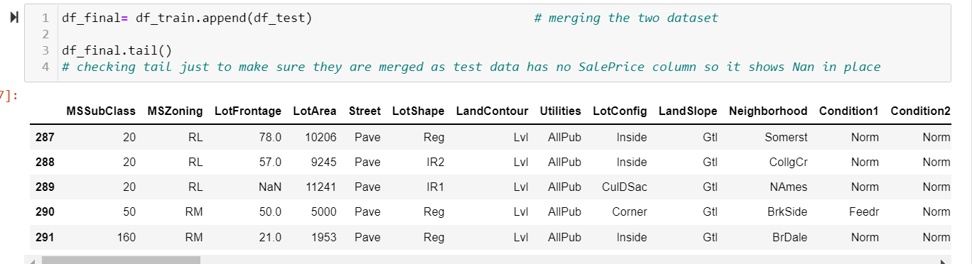
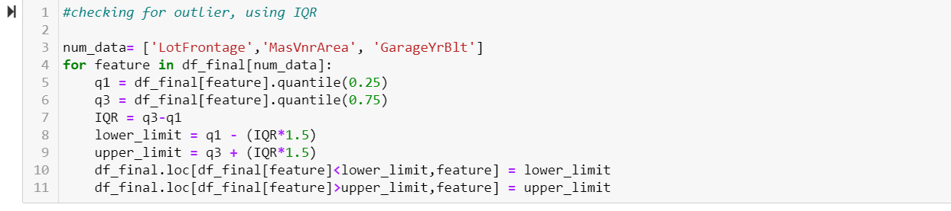
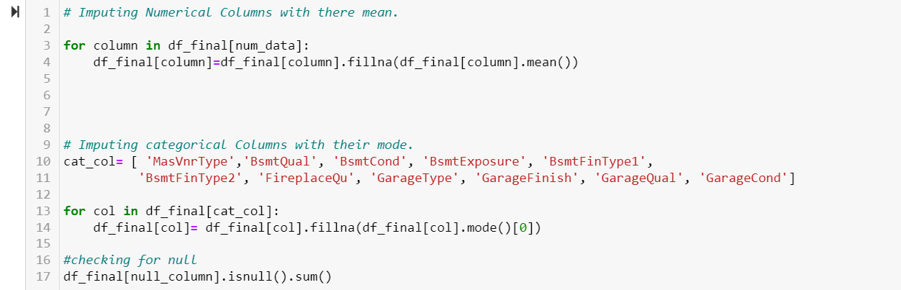
Merging two datasets
Taking care of outliers
Imputing categorical and continuous column.

Slide 26
Encoding
Encoding is a technique of converting categorical variables into numerical values so that it could be easily fitted to a machine learning model.
For encoding also we divide our categorical columns into two category:
1. Nominal Data: we encode this data using label encoder here.
2. Ordinal data : we encode Ordinal data using Ordinal encoder.
After encoding , we once check the entire values, then again split the train dataset and test dataset, as we will not do skewness and outlier detection and removal on test dataset.

Slide 27
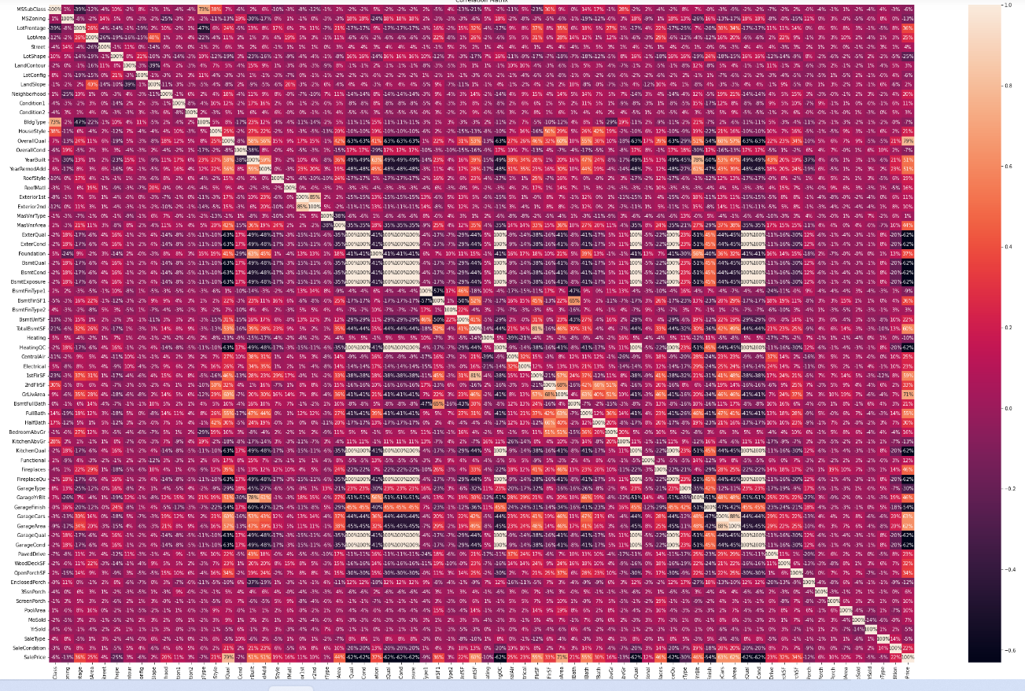
Correlation on Encoded dataset.

Slide 28
Observations
We can observe that MSSubClass is 0% related to sale price, othe columns which are least related to Sale Price are : LandContour, LandSlope, Condition2, MasVnrType, BsmtFinType2, Street.
Let's go ahead and drop them as well.
We can also observe that GarageQual, GarageCond, ExterQual, ExterCond, BsmtQual, BsmtCond, BsmtExposure, HeatingQC, KitchenQual, FirplaceQu are also highly correlated. However these are Categorical columns, so we must run chi squared test to confirm it. We will do it if it is necessary.
We also able to observe that TotalBsmtSf and 1stFlrSF are also correlated. Similarly Exterior1st and Exterior2nd also show high correlation
We can either drop these categorical columns or will kept it for once, and see if it really affect the over all more, cause deriving multicollinearity connection of categorical columns using Correlation matrix is not really recommended.

Slide 29
Skewness and Outlier Detection & Removal
Skewness is the measure of how much the probability distribution of a random variable deviates from the normal distribution.
Skewness detection and removal is basically done on continuous features only, we cannot disturb the categorical features and our label data. Same thing goes for Outliers also.
For skewness detection we use .skew().
In this dataset we choose the threshold for skewness score to be +/-1, any value greater than this considered to be skewed.
And for skewness removal we perform PowerTransformer on the skewed continuous columns, which helps to reduce the skewness to a great level.

Slide 30
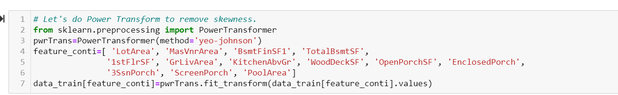
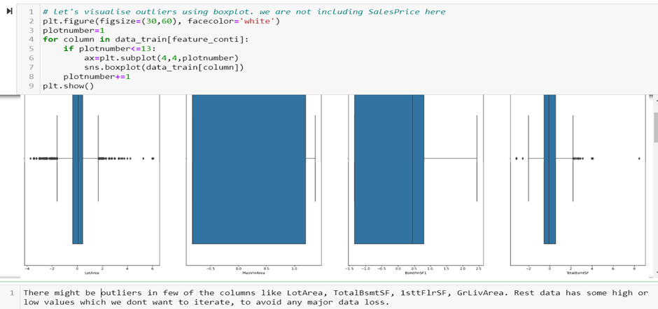
For Skewness removal we perform PowerTransformer.
Visualization of outliers using BoxPlot
For removal of outliers we can perform Z score method, on the columns which has outliers

Slide 31
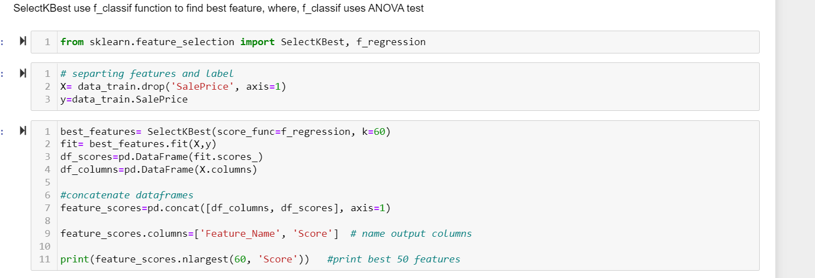
Selecting Best Features: For this we are using SelectKBest Feature Selection Technique.

Slide 32
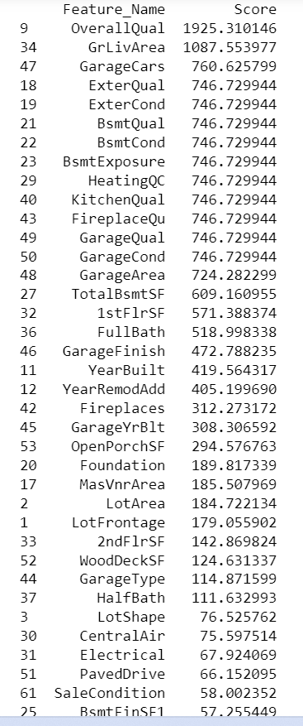
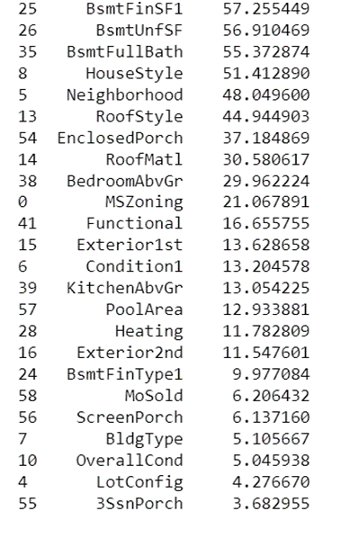
List of Best Features in descending order obtained from SelectKBest Feature selection technique.

Slide 33
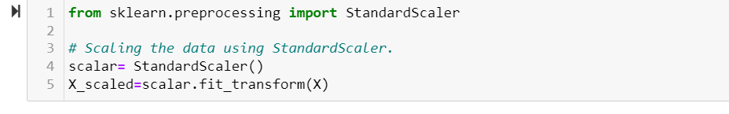
Scaling
It is performed during the data pre-processing to handle highly varying magnitudes or values or units.
Here are using standardscalar technique to scale our data, one thing to note here is that, scaling is done only on features not on label, So we already separate our label and features. Here X is our features.

Slide 34
Model Building
For ML model building we need to first split our dataset into train set and test set, so here we split our processed train dataset into 75% train and 25% test set using train test split model selection technique.
We also need to import all the necessary metrics and libraries for different algorithms.
As our is regression model, we decide out best model on the basis of high r2 score and low root mean squared error and mean absolute error.
We Perform Linear Regression, Lasso(regularization Techniques) , randomForest Regressor (ensemble technique), We also build AdaBoost Regressor and XGBoost Regressor Algorithm justb to decide which works best for our dataset.

Slide 35
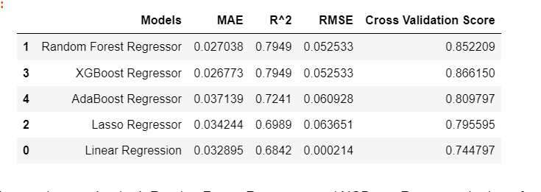
Summarizing all the Models/Different Algorithms
We can observe that both RandomForest Regressor and XGBoost Regressor both perform almost similar, we will select RandomForest over XGBoost as the difference between training score and testing score is less for Randomforest as compared to XGBoost.

Slide 36
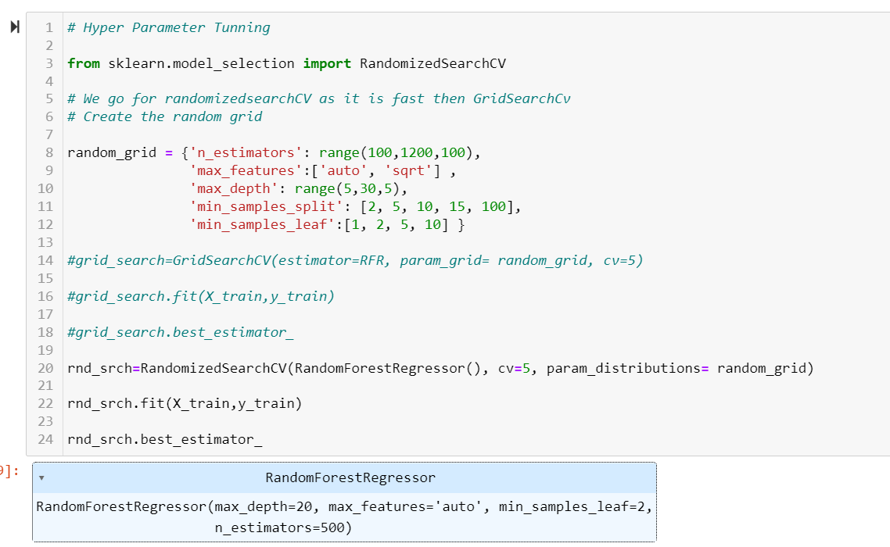
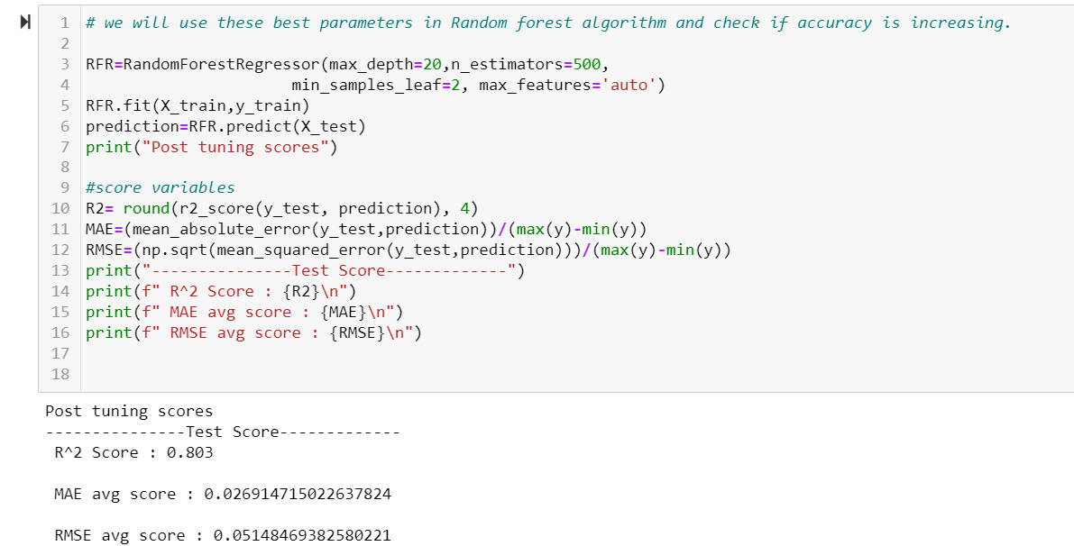
After deciding on final model, we did hyper parameter tuning for our final Model , in this case it is RandomForest Regressor Model.
For Hyper parameter tuning we use RandomizedSearchCV technique, as it is both efficient and fast . However the accuracy of GridsearchCv is high, but it takes a lot more time on high number of data.

Slide 37
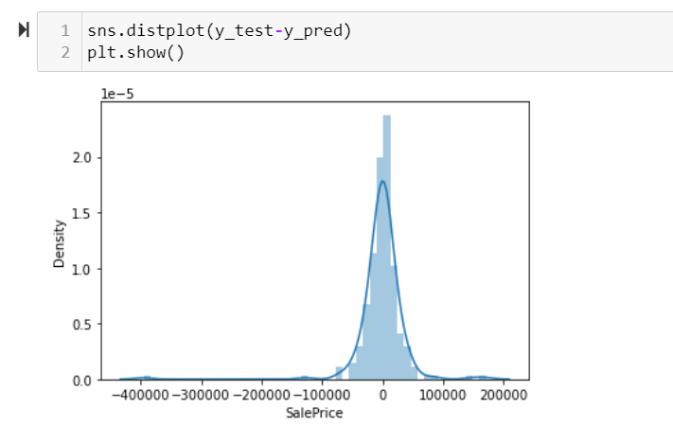
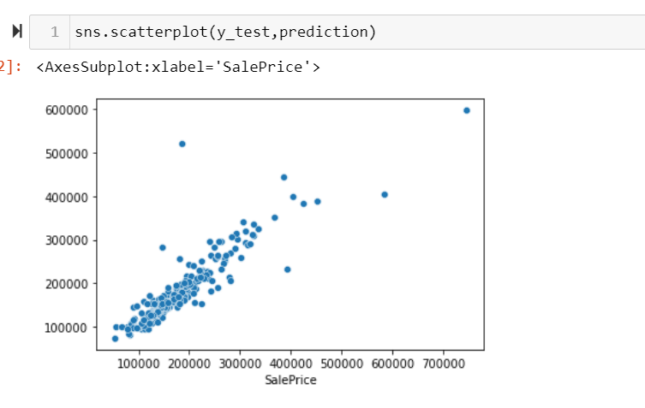
Visualization of result
From bothn of the above visualization it is clear that RandomForestRegressor is the final model which Suits our Dataset best. Now using this Model we will Perform the prediction for Test dataset. But Before that we need to save this model.

Slide 38
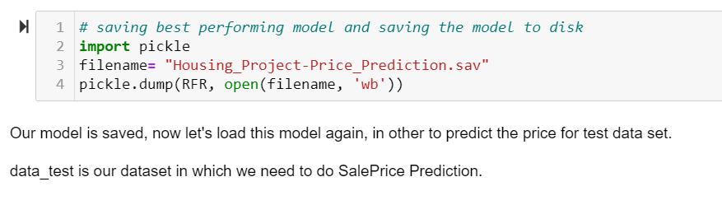
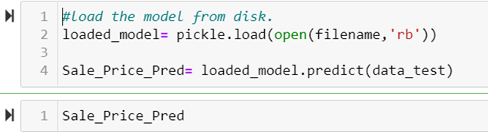
Saving & Prediction
We use pickle technique to save the final model. And for test dataset prediction we load the model back and then do the prediction.
Sale_Price_Pred is the predicted sale price for the test dataset. Which can be used for Predicting weather to Buy or not Buy a property.

Slide 39
Conclusion
As we know that real life dataset some with lots of missing information and are skewed to some degree, so it is very necessary to clean the data, and make it suitable as it can fit for the ML model building Algorithms.
As the number of columns in our dataset are very high, its very important to understand the data very carefully, so to avoid any data or information law, we did drop few of the columns in the process, with legitimate reasons.
One can perform VIF approach in order to avoid multicollinearity, as it sometimes hampers with the results.
One can select even less number of columns in Feature selection and go for Building the model using selected best columns only, this will definitely saves lot of time and energy in return money for the organization.
Overall, Our dataset works best with RandomForrest Regressor Algorithm, we get decent r2 score and even minimum error. And if one can remove multicollinearity than might be our model scores even better.
There are always scopes for improvement in every model, And one can do as much work as possible in finalization.

Slide 40
Thank You.

